Slide 1




SAE NIS EFFI-CYCLE 2023 >>>Future Mobility<<<
MARKETING PRESENTATION
<23056>
<Green Warriors>
<Aligarh Muslim University>
<Aligarh, Uttar Pradesh>

Slide 2
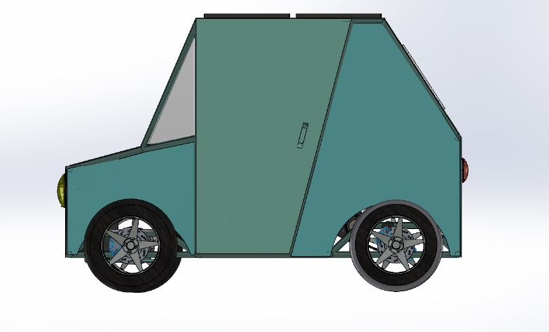
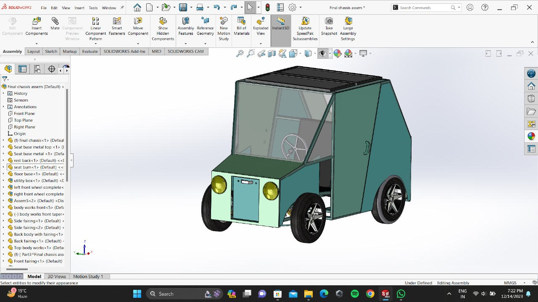
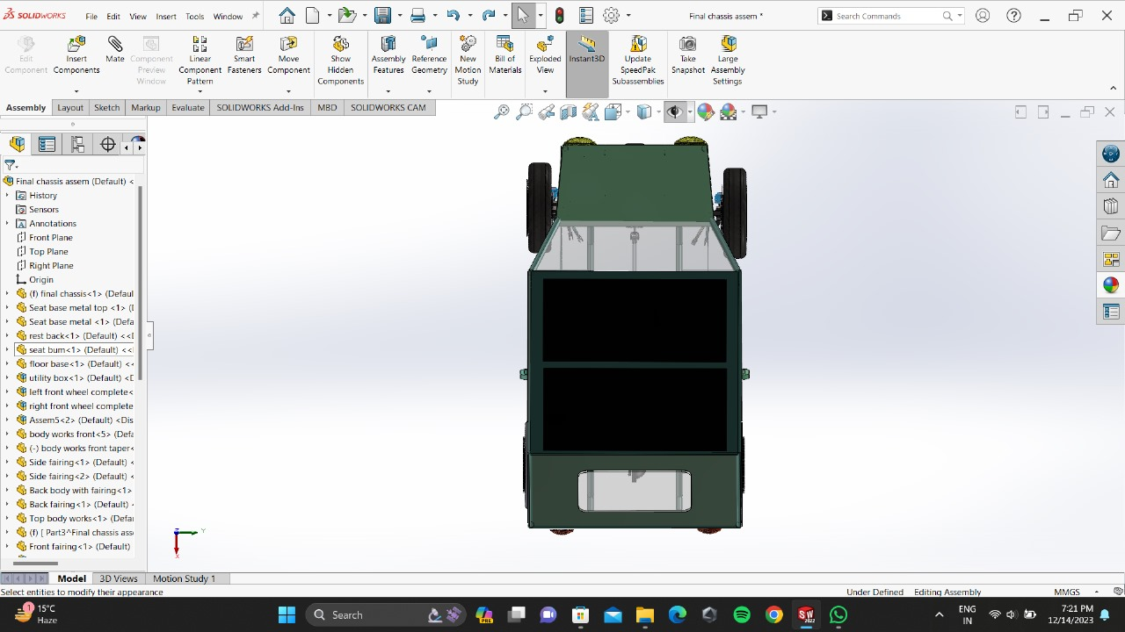
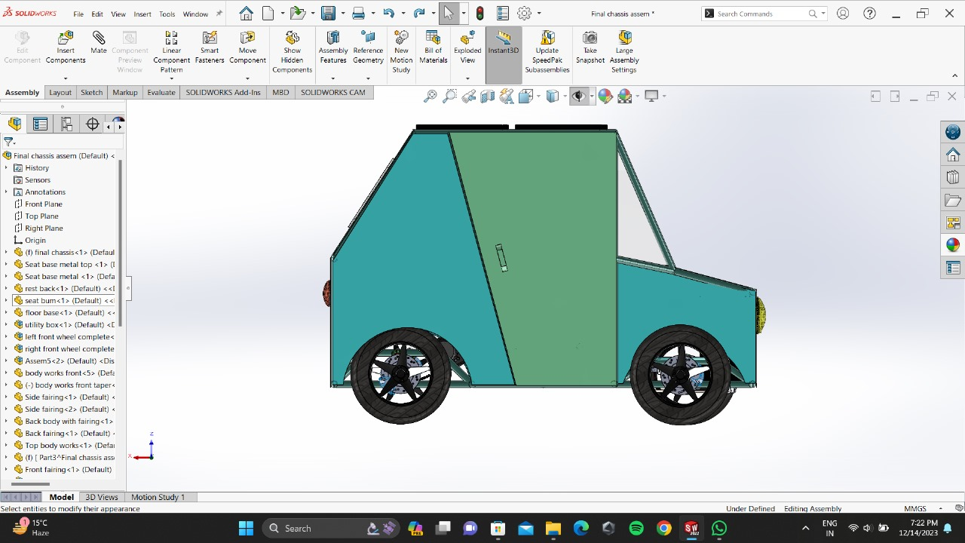
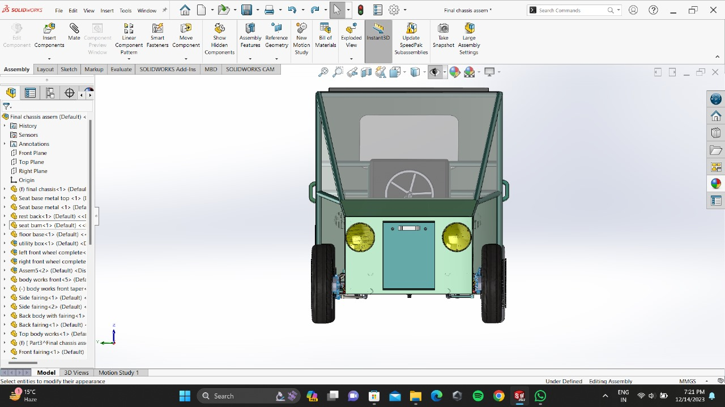
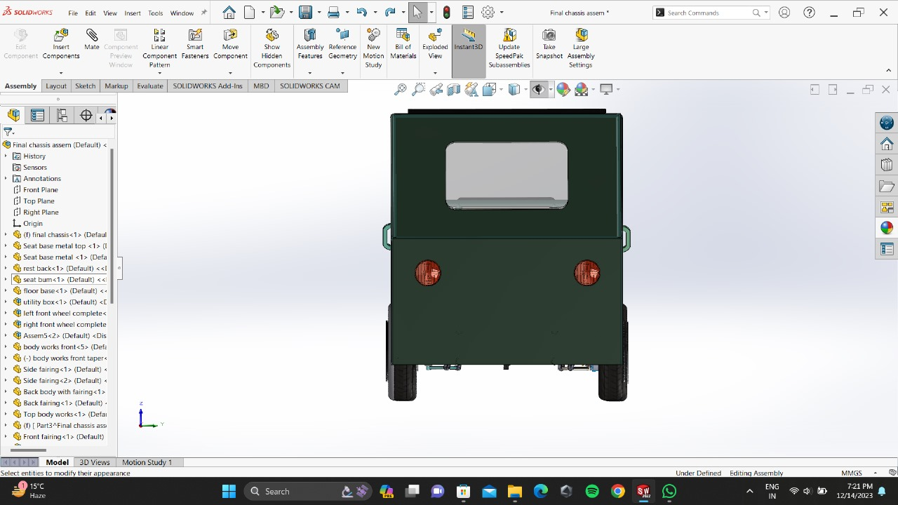
Vehicle Views

Slide 3
Features of Electric Vehicle
Accident Alert System
Rear and Front Wheel Suspension
Fast charging capablity
Seat belt alert System
Driver Drowsiness Alert System
Reverse parking Assist

Slide 4
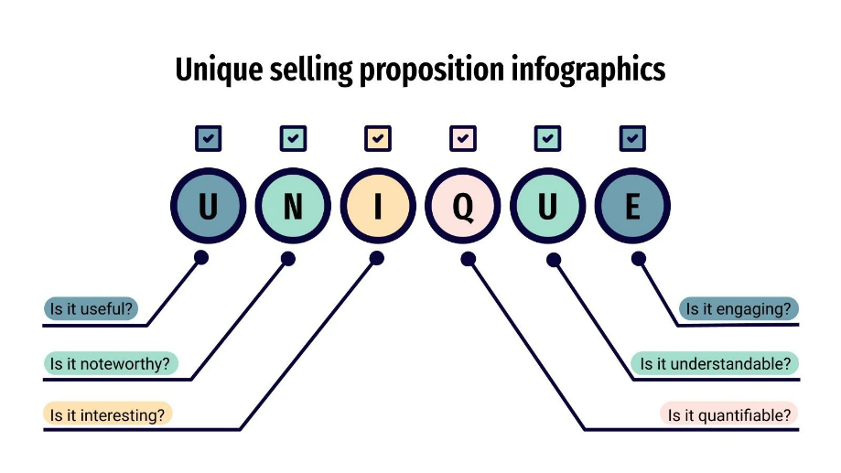
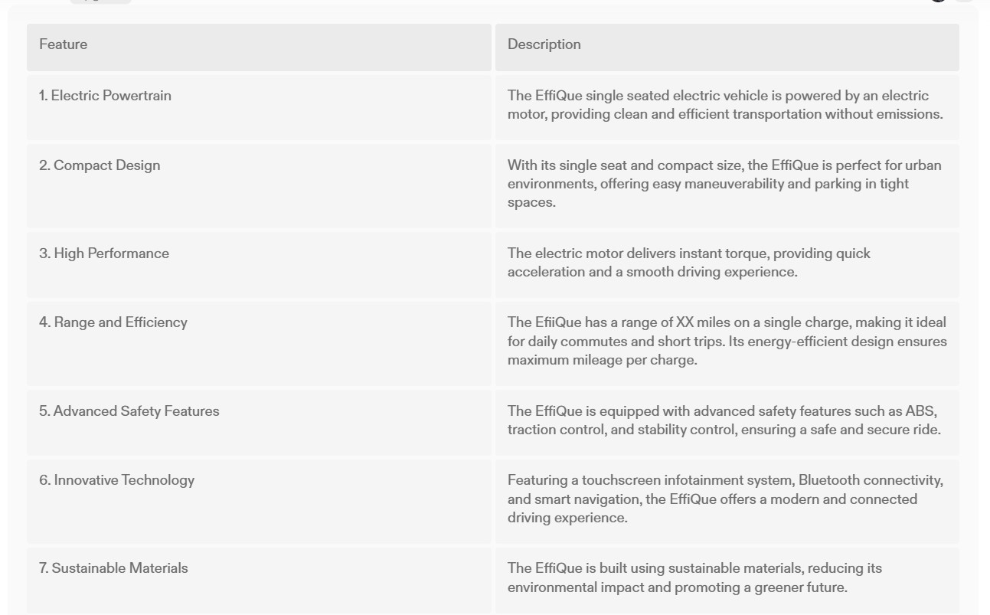
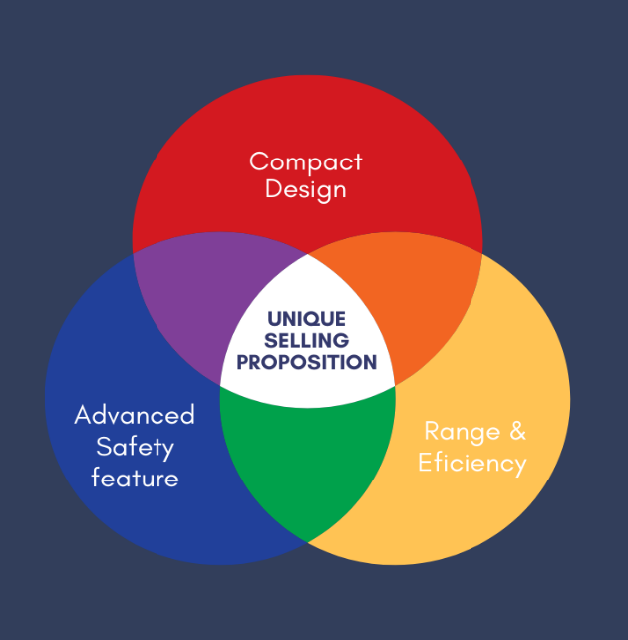
Unique Selling Proposition(USP)
A unique selling proposition—or USP
—is a statement of what makes your business stand out from the competition

Slide 5

Different concepts and Variants
Parameters | EffiQue 11.0 |  | Microlino | Citroen AMI One | Toyota C+ Pod
Price | Rs. 1.25,315 |  | Rs. 8,70,727 | Rs. 5,23,445 | Rs. 10,80,793
Electric only miles between charges | 36 |  | 59 | 43 | 90
Battery | 1.68 kWh |  | 6 kWh | 5.5 kWh | 9.06 kWh
Dimensions | Length = 2.0828m Breadth = 1.473.2 m |  | Length = 2.435 m Breadth = 1.500 m | Length = 2.410 m Breadth = 1.390 m | Length = 2.250 m Breadth = 1.300 m
How fun is it to drive ? | Ergonomically designed, with joystick type steering makes the vehicle very easy and comfortable to drive. |  | Two-seater, space saving light weighted vehicle which fulfils the needs of a city dweller. | Compact design makes it perfect for zipping around town with two aboard. | Can go to places where larger vehicles cannot enter because of its compact design
Who will drive it ? | Students, urbanites, health enthusiasts who want a healthy & comfortable ride. |  | People who need to travel short distances in quick time. | Urbanites for travelling small distances. | Mobility option for short urban journeys.
Will it be around in 10 years ? | Its perfect design & efficient performance can ensure its existence in the future also with many variants yet to come. |  | Probably, as Micro have pioneered electric scooters and cars since moving on to electric three- wheeled mopeds. | Likely so, as the design is made such that it can be upgraded in later years. | Yes, with the expansion of EV industry, currently it sold only in Japan.
EffiQue11.0
Microlino
Citroen AMI one
Toyota C+ Pod

Slide 6
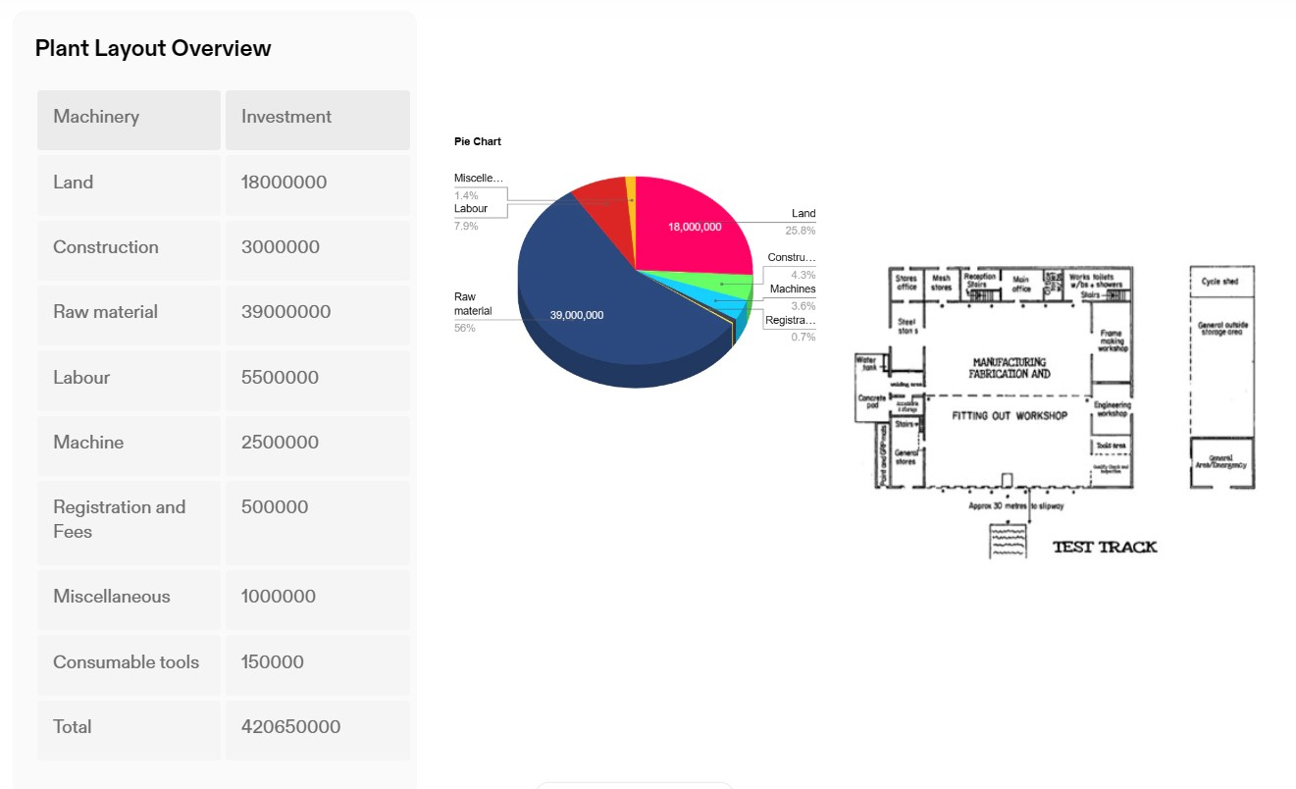
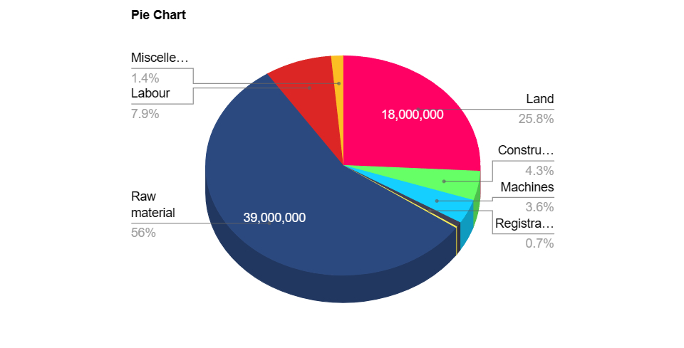
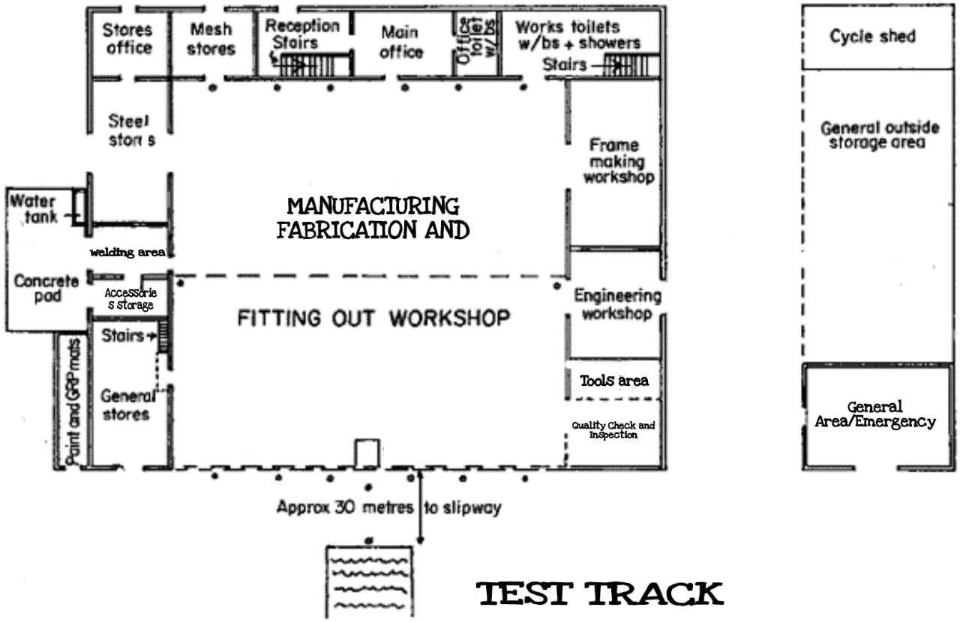
Plant Layout for Mass Production

Slide 7

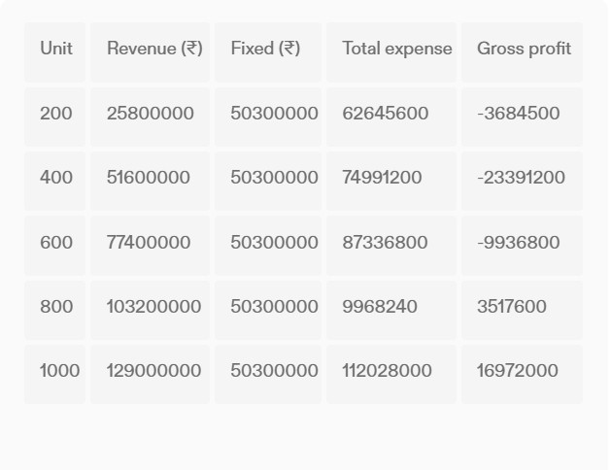
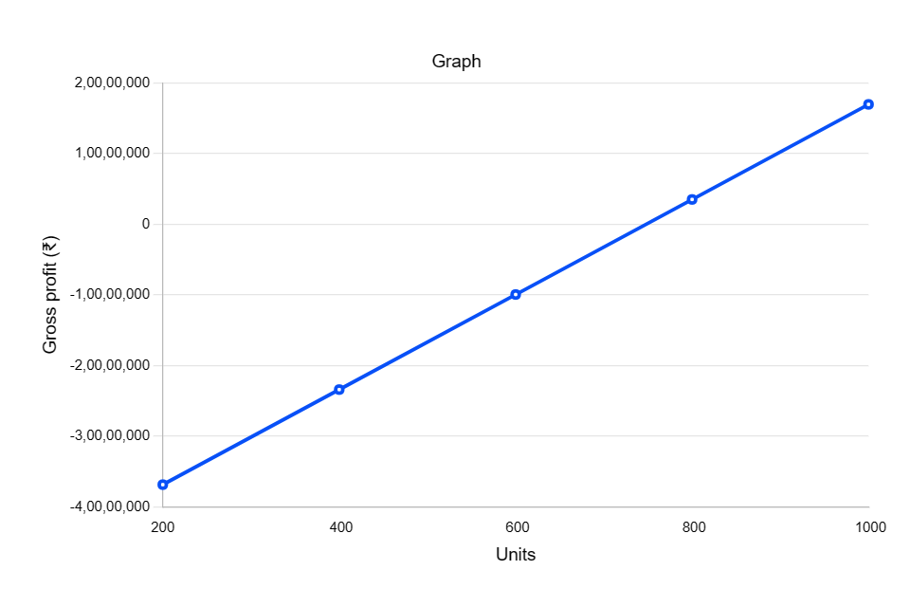
Cost of Product in Mass Production
Mass production costs involve raw materials, labor, and overhead
for competitive pricing and sustained profitability through efficient processes.

Slide 8
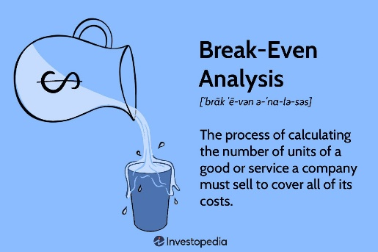
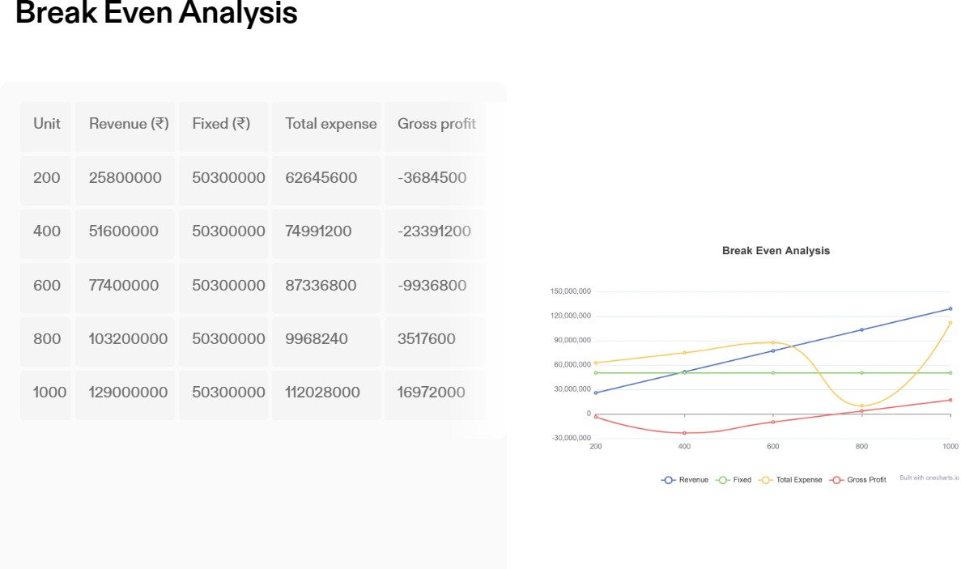
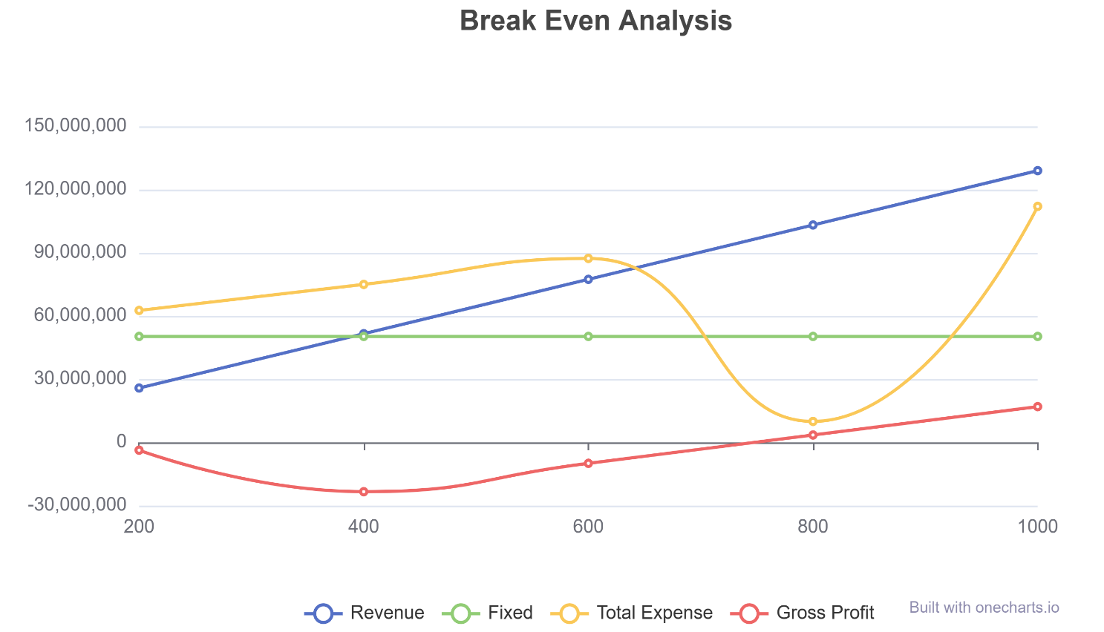
Break even analysis
A break-even analysis helps business owners find the point at which their total costs and
total revenue are equal, also known as the break-even point in accounting .

Slide 9
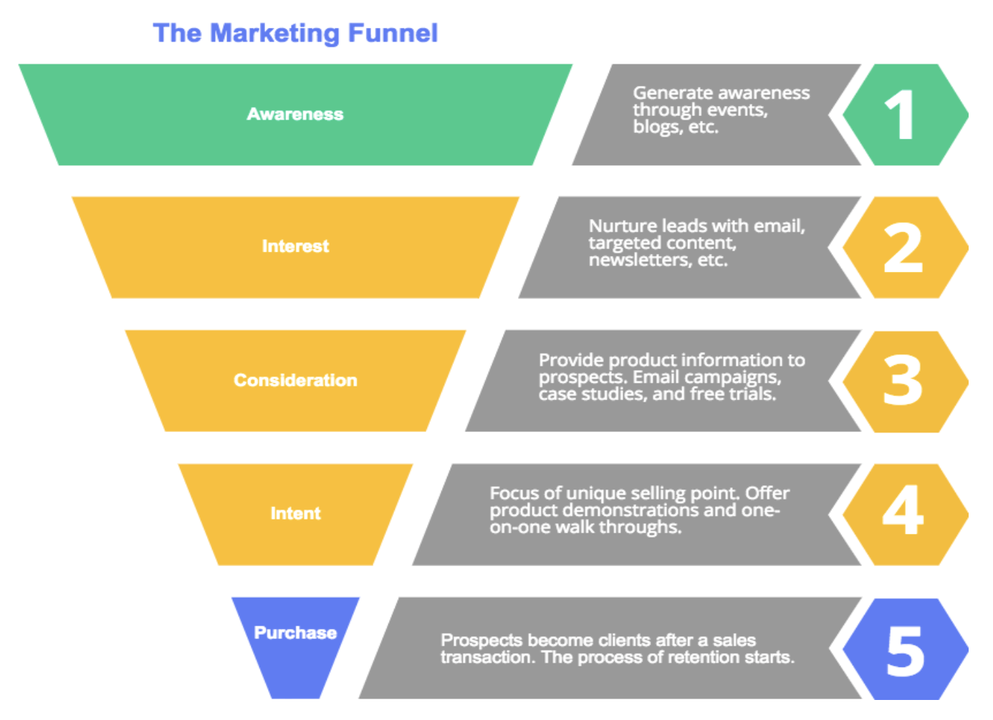
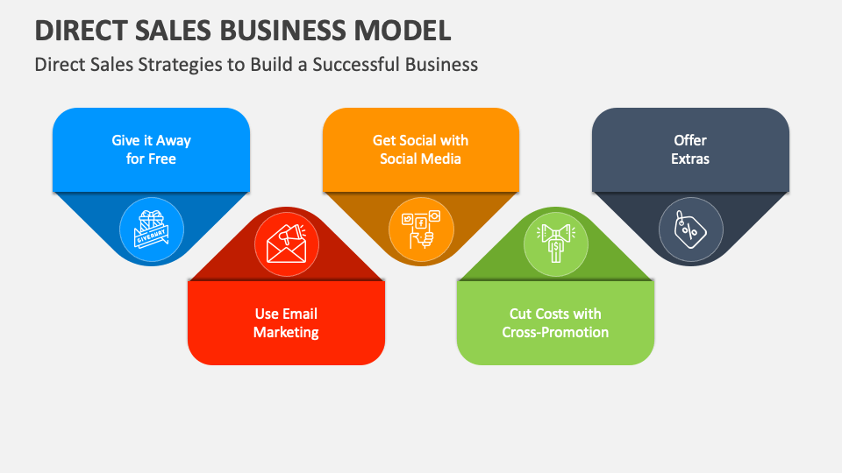
Promotional Strategies
"Elevate your urban commute with our single-seated electric vehicles — the epitome of green, compact, and stylish transportation."
Eco-Friendly appeal
Cost Saving and Incentives
Smart and Teach Savvy Features
Urban Mobility solution
Personalization Option

Slide 10
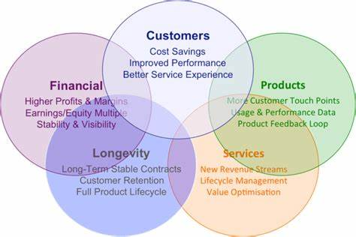
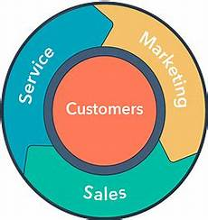
After Market Strategy
Customer Support
Accessories
Upgrade
Warranty

